Slide 1
Azure Fundamentals part 1
Describe core cloud concepts

Slide 2
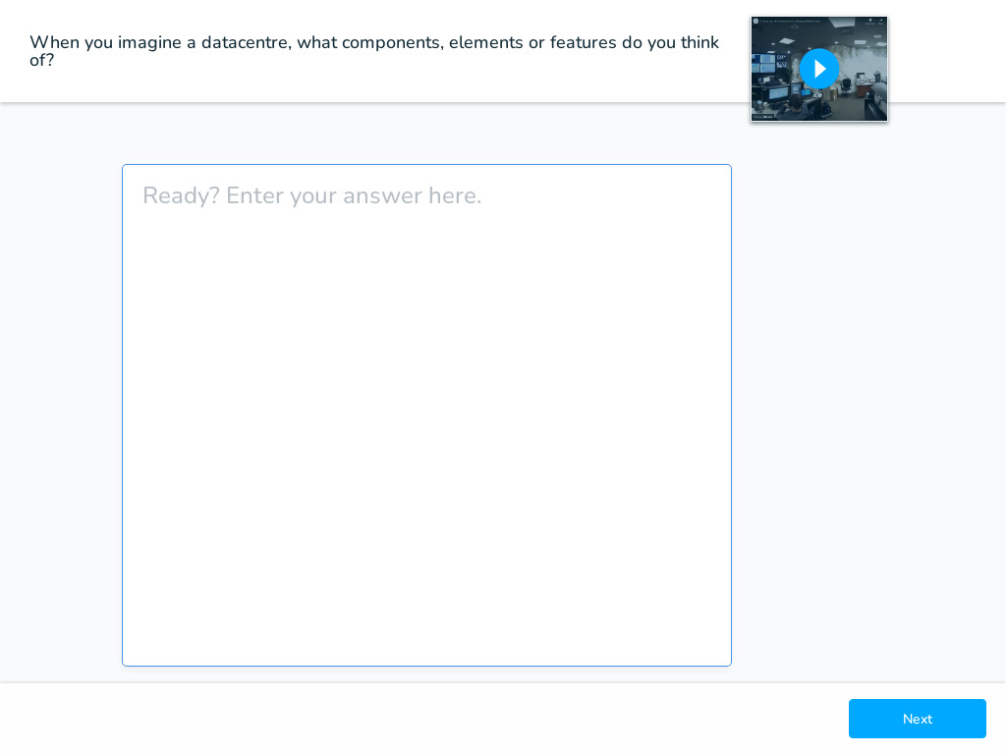
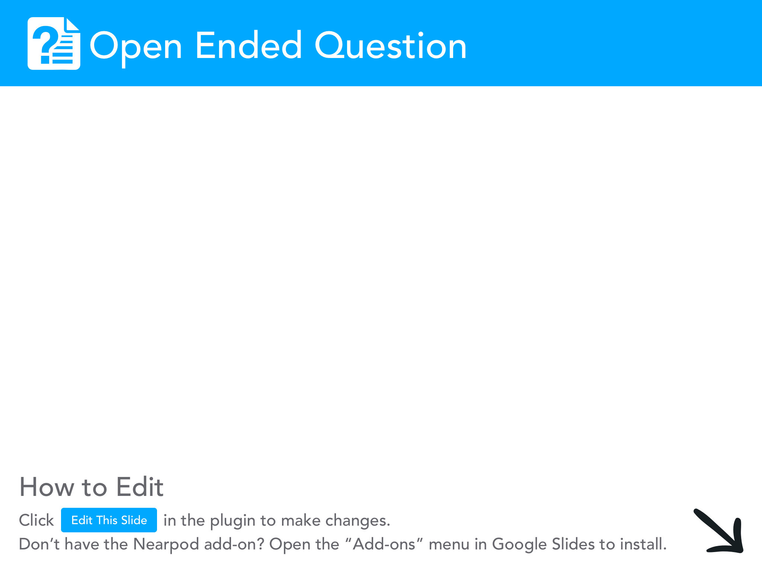

Slide 3
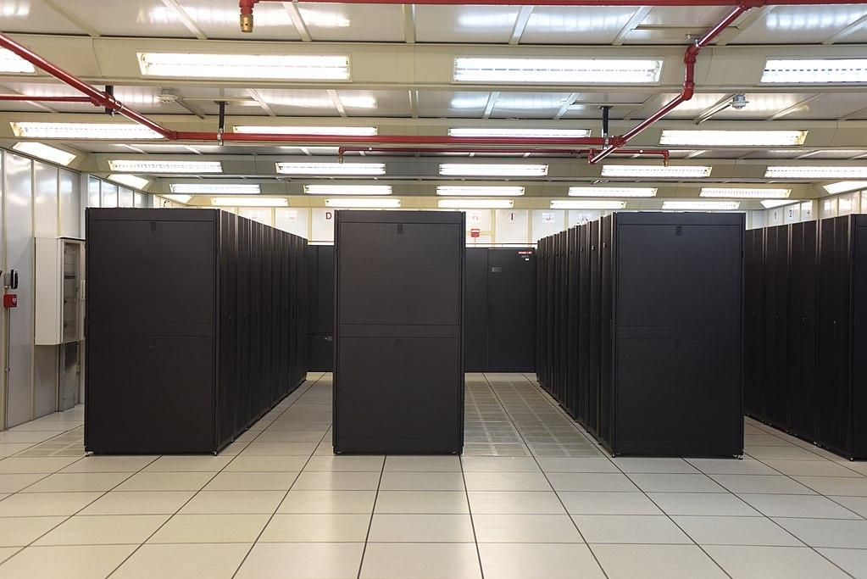
Datacentre
This was traditionally
Co-location is also
An option

Slide 4
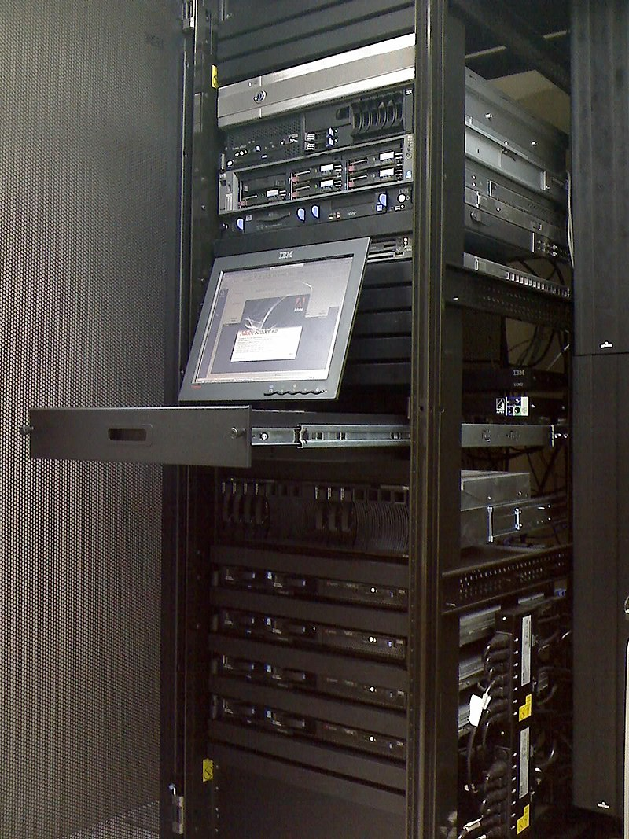
Service
KVM access

Slide 5
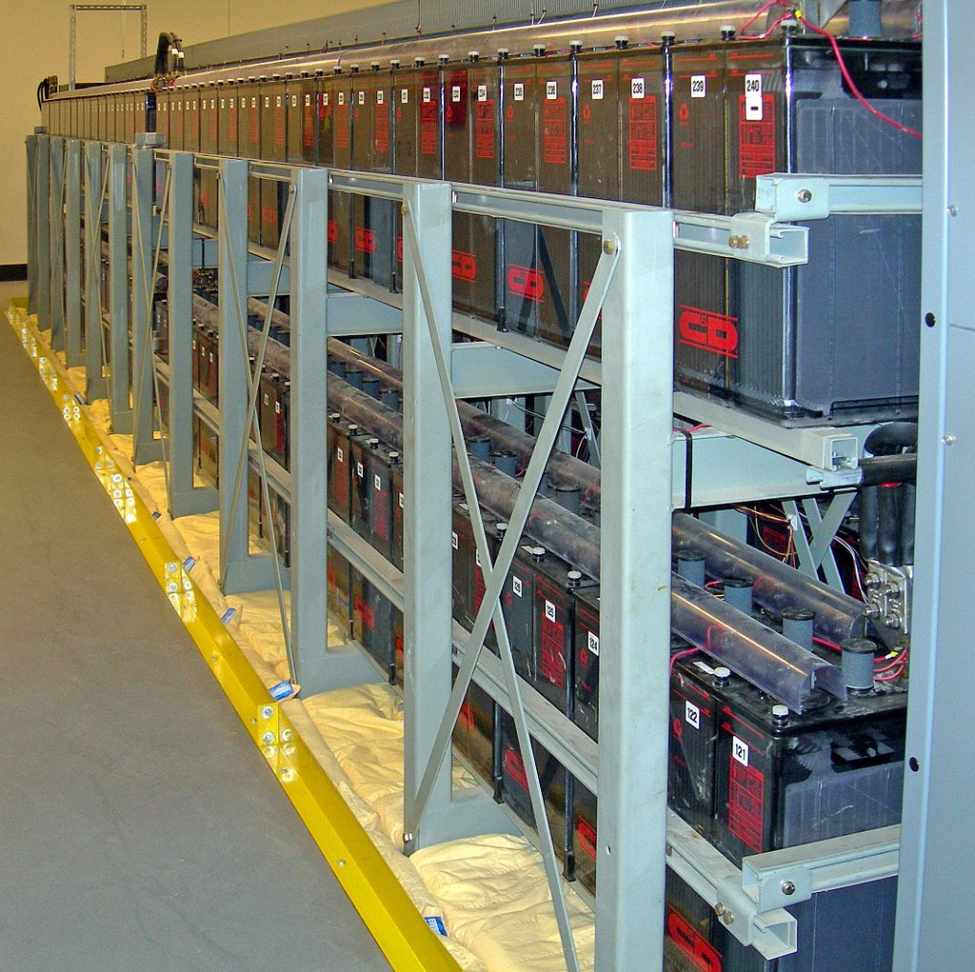
What is this
Hint
Nobody likes
An outage

Slide 6
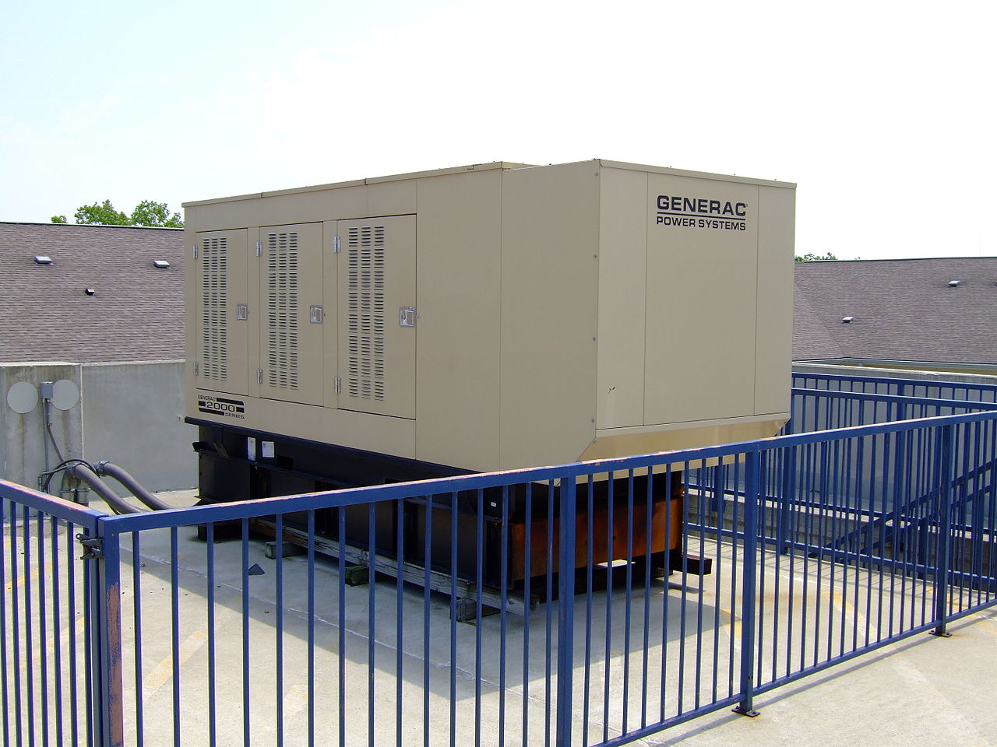
What is this
Hint
Nobody likes
An outage

Slide 7
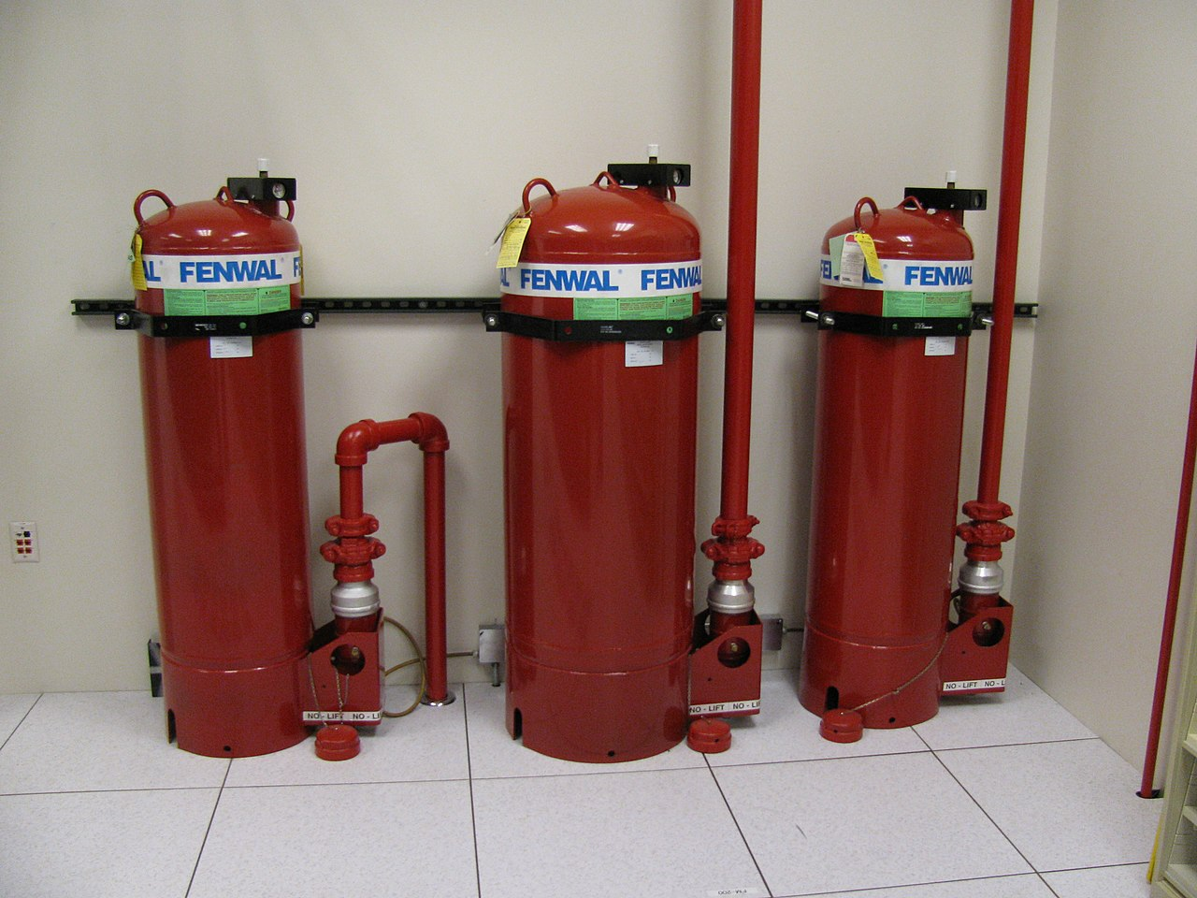
What is this
Hint
It’s not water

Slide 8
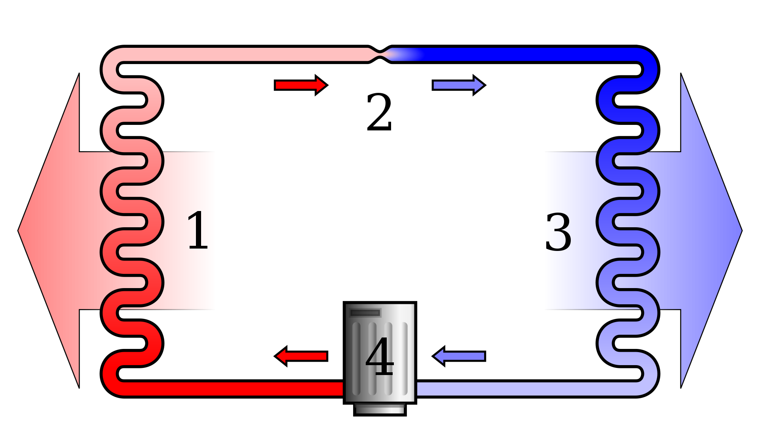
What is this
Hint
Computers can
Handle more
Heat than
Humans can
Very high temp reduces
components lifespan

Slide 9
Interesting note: Co-location
Nearly all traffic in Ontario passes through
151 Front Street West in Toronto
Rumour has it, so does Cape Breton!

Slide 10
Telecommunications
As an example of 151 Front Street
150+ unique networks in onsite Meet Me Room within Cologix facility plus direct access to building’s MMR
Home to the Toronto Internet Exchange, TorIX
Diverse building fiber entrance and riser facilities
Network-neutral facility

Slide 11
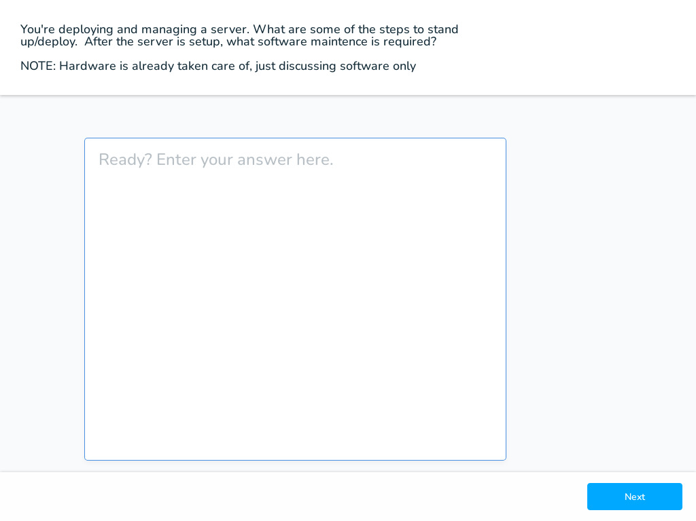

Slide 12
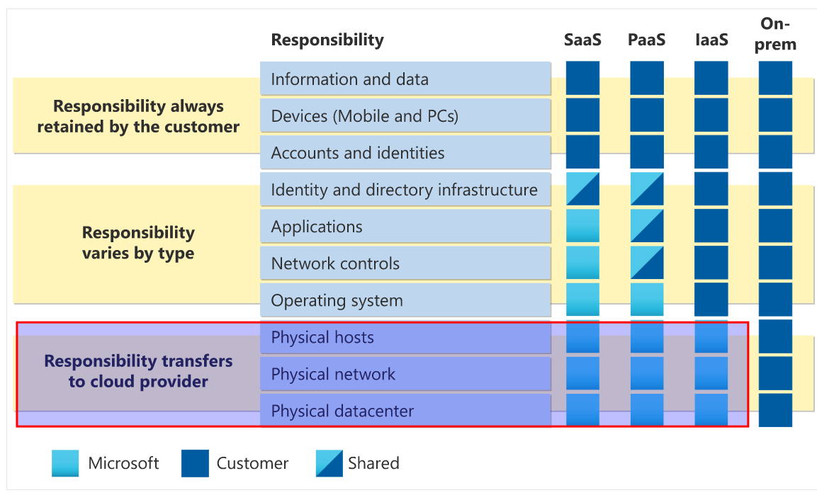
IaaS
Not our problem
Capex to Opex
For DC duties

Slide 13
IaaS - Scenarios
Lift-and-shift migration: You’re standing up cloud resources similar to your on-prem datacenter, and then simply moving the things running on-prem to running on the IaaS infrastructure.
Testing and development: You have established configurations for development and test environments that you need to rapidly replicate. You can stand up or shut down the different environments rapidly with an IaaS structure, while maintaining complete control.

Slide 14
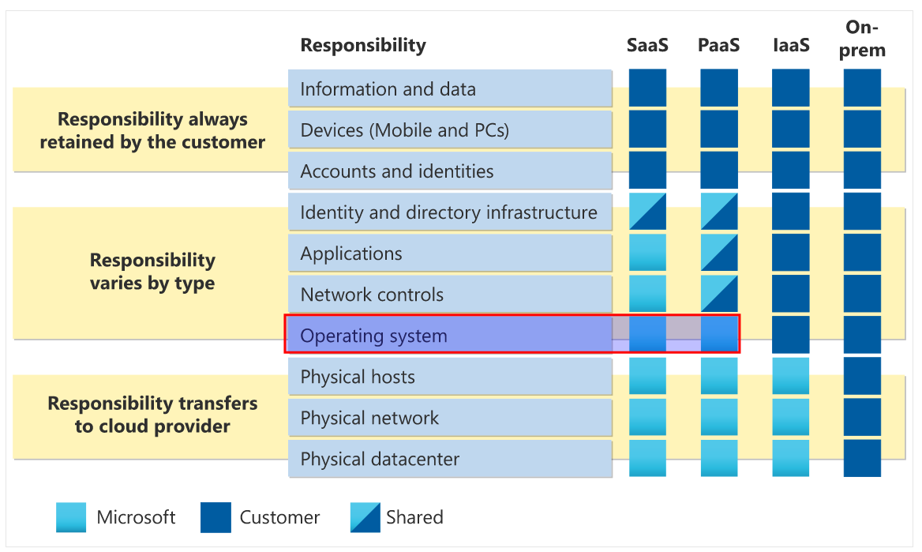
PaaS

Slide 15
PaaS - Scenarios
Development framework: PaaS provides a framework that developers can build upon to develop or customize cloud-based applications. Similar to the way you create an Excel macro, PaaS lets developers create applications using built-in software components. Cloud features such as scalability, high-availability, and multi-tenant capability are included, reducing the amount of coding that developers must do.
Analytics or business intelligence: Tools provided as a service with PaaS allow organizations to analyze and mine their data, finding insights and patterns and predicting outcomes to improve forecasting, product design decisions, investment returns, and other business decisions.
Think of PaaS like using a domain joined machine: IT maintains the device with regular updates, patches, and refreshes.

Slide 16
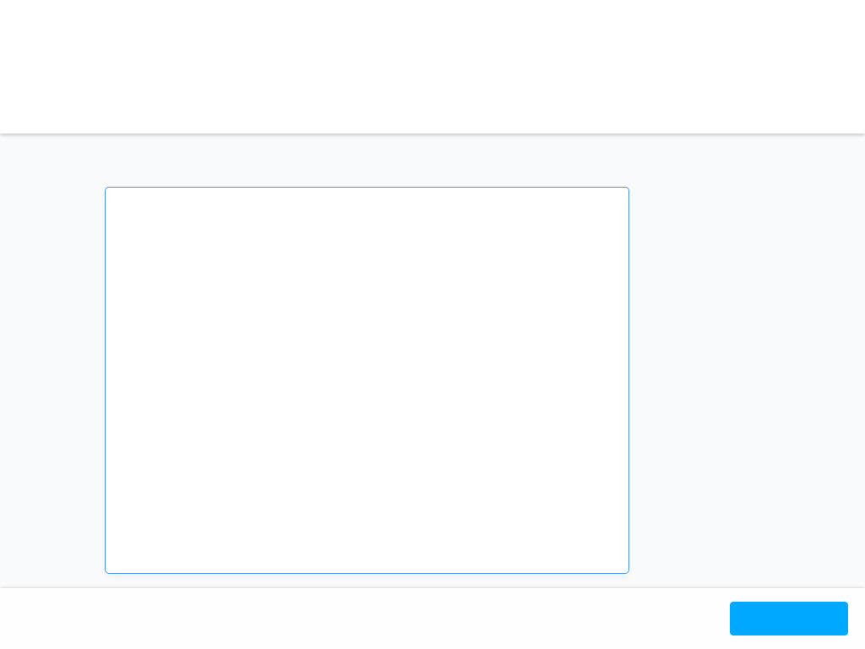

Slide 17
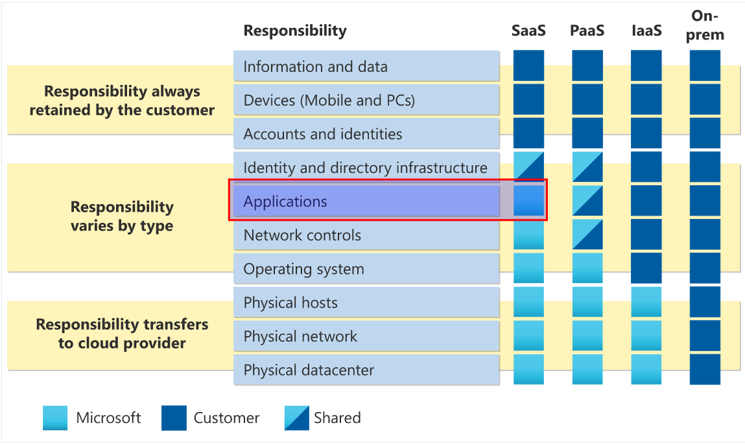
SaaS
Office 365
Google Docs

Slide 18
SaaS - Scenarios
Email and messaging.
Business productivity applications.
Finance and expense tracking.

Slide 19
No responsibilities!
Not so fast..
You’ll always be responsible for:
The information and data stored in the cloud
Devices that are allowed to connect to your cloud (cell phones, computers, and so on)
The accounts and identities of the people, services, and devices within your organization

Slide 20
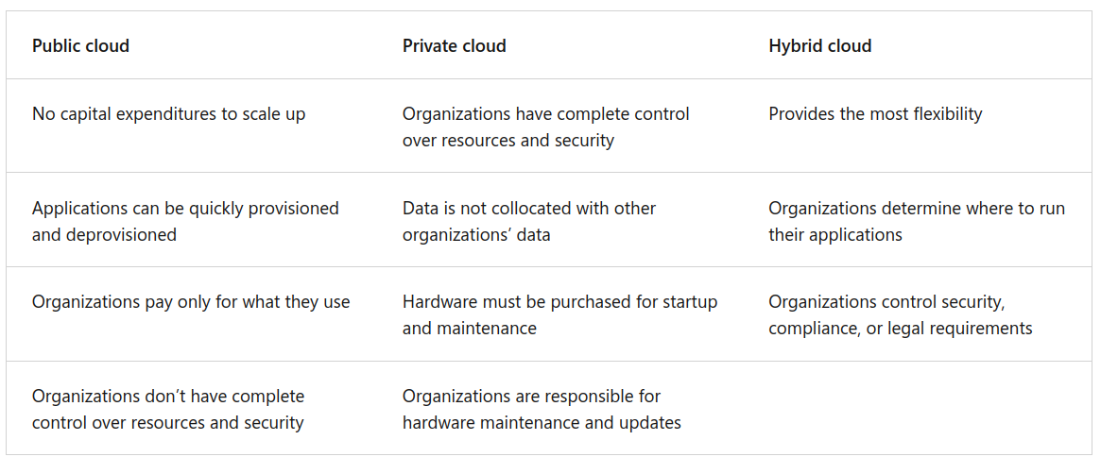
Why pay for private cloud?

Slide 21
Private cloud
-You can run Azure private cloud in your own data centre
-Integration with Azure Public Clouds (what does this become?)
-Heavily rely on Microsoft-centric infrastructure, applications and tools

Slide 22
Azure SLA - High Availability
Options: 99%, 99.9% 99.95%, 99.99%
99% 1.68 hrs/week, 7.2hrs/month
99.9% 10 min/week, 43.2 min/month
Two 9s vs three 9s.
Formal agreement between provider and customer

Slide 23
Scalability
Vertical - adding more CPU or RAM
Horizontal - adding and removing instances: VMs or containers
Note: horizontal scaling can be automated

Slide 24
Microsoft Azure Well-Architected Framework pillar 1 of 5
1. Right-size resources: Choose the most appropriate resource types and sizes based on workload requirements, and continually monitor and adjust resource allocation to avoid over provisioning and minimize costs.
2. Utilize cost management tools: Leverage Azure Cost Management and other cost monitoring tools to gain insights into your spending, identify cost-saving opportunities, and set budgets and alerts to ensure effective control over cloud expenditures.

Slide 25
Governance
1. Cloud governance and compliance: Utilize set templates to align resources with corporate standards and regulatory requirements, and leverage cloud-based auditing to identify non-compliant resources and mitigation strategies.
2. Security and flexibility: Choose the right cloud service model (IaaS, PaaS, or SaaS) to match security needs, and benefit from cloud providers' robust defenses against threats like DDoS attacks, ensuring a secure and well-managed cloud environment.

Slide 26
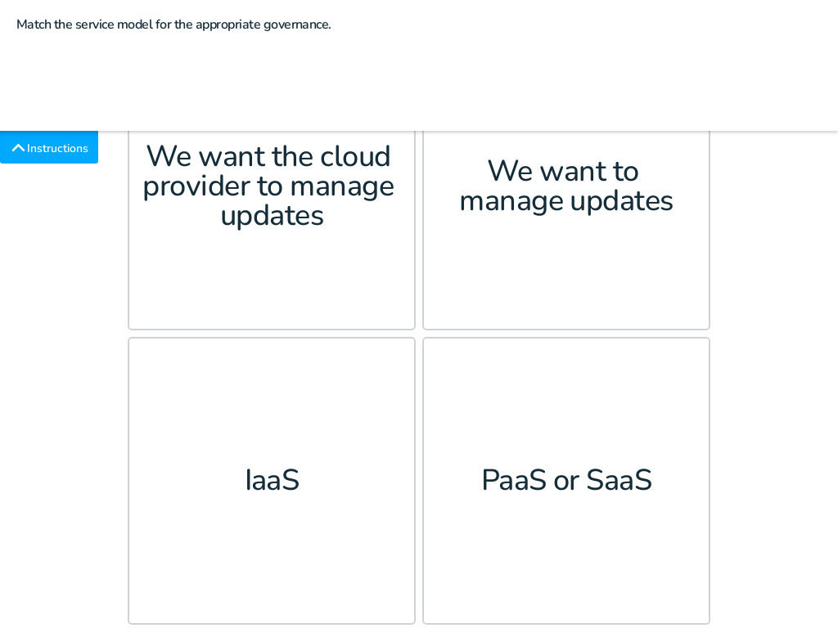
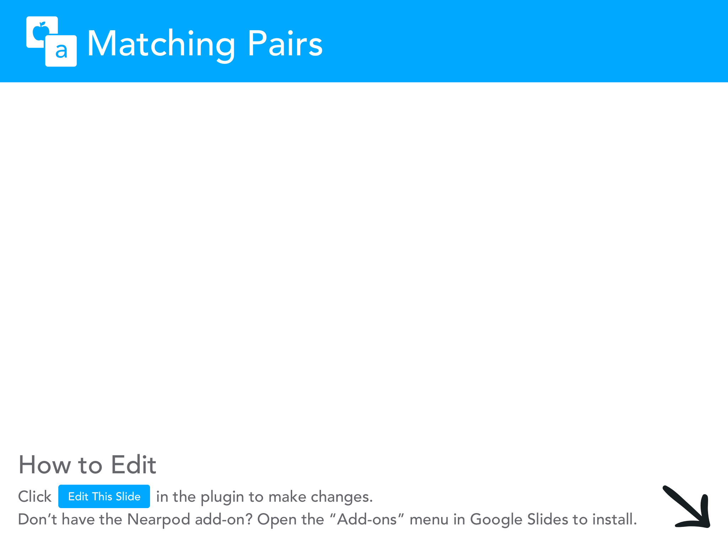

Slide 27
Management options
Through a web portal.
Using a command line interface.
Using APIs.
Using PowerShell.

Slide 28
Homework: concepts on exam
Complete
Microsoft Azure Fundamentals: Describe cloud concepts
https://learn.microsoft.com/en-us/training/paths/microsoft-azure-fundamentals-describe-cloud-concepts/

Slide 29
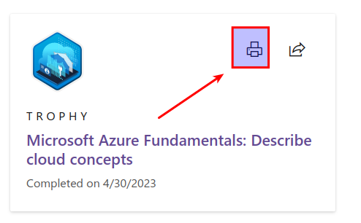
Access the achievement

Slide 30
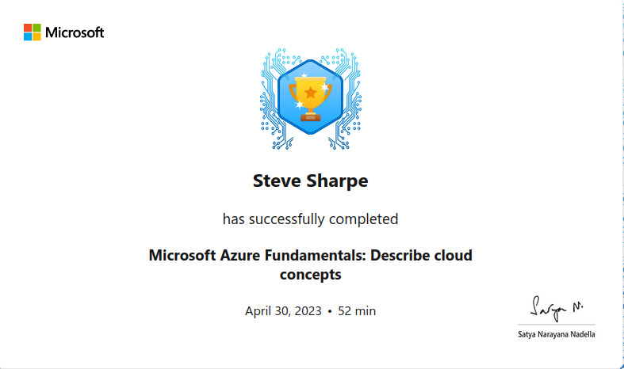
Correct trophy with your name

Slide 31
Credits
Images: Wikipedia

